Slide 1
IBM University Engagement Project Submission
“Exploring the Power of Agentic AI with IBM Granite and LangFlow”

Slide 2

Project Tile – Interview Trainer Agent
Domain of Project – Education
Student Name | Recent Passport Photo | Email ID | Mobile number [WhatsApp]
Vidya Vijay |  | vidyavijay057@gmail.com | 8089643206

Slide 3
Problem Statement
Problem Statement : – Interview Trainer Agent
The Challenge
Landing a tech job requires thorough preparation, but job seekers often struggle with unstructured study plans, role-specific questions, and realistic feedback. Preparation guidelines and interview patterns are scattered across various portals. Without personalized, real-time guidance, candidate confidence and interview success rates remain low.
The Objective
Build an AI-powered Interview Trainer Agent powered by RAG (Retrieval-Augmented Generation) that prepares users for job interviews by generating tailored question sets and preparation strategies based on their profile, experience, and target role.
The solution should:
Personalized Preparation Plans– Generate tailored preparation roadmaps and timelines based on target job role, experience level, and key skill sets.
Interview Data RAG Retrieval – Fetch and retrieve role-specific technical questions, behavioral scenarios, and model answers from curated recruitment databases.

Slide 4
Comprehensive Skill Assessment – Support both technical and soft skill evaluation,
providing model answers and actionable improvement tips..
Career & Skill Focus – Suggest focus areas and target milestones for technical growth and
interview readiness.
Multi-Agent System :
Strategy & Roadmap Agent (generates structured study plans and timelines)
Assessment & Feedback Agent (evaluates candidate responses and gives suggestions)
Knowledge RAG Agent (retrieves technical questions and domain expectations)
Interactive User Dashboard– Display structured question sets, study roadmaps, and
preparation progress.

Slide 5
Proposed Solution
Proposed Solution: AI-Powered Interview Trainer Agent
The proposed solution is a multi-agent AI-powered Interview Trainer Agent built using LangChain/LangFlow, IBM watsonx.ai, and Granite Models to provide personalized, real-time interview preparation guidance. The system addresses challenges in candidate preparation, topic-by-topic study roadmaps, and mock answer evaluations through an intelligent, modular architecture.
At its core, the solution uses a Retrieval-Augmented Generation (RAG) pipeline to fetch accurate interview data from trusted technical databases, recruitment guidelines, and model question banks. This data is embedded and stored in a vector database, enabling the system to retrieve and summarize targeted technical and soft skill prep details using Granite models.

Slide 6
The system consists of key specialized agents:
Interview Knowledge RAG Agent retrieves and summarizes role-specific interview questions and model answers using RAG.
Preparation Strategy Agent generates personalized study roadmaps based on user inputs such as target job role, experience level, and key skills.
Skill Assessment Agent provides targeted technical and soft skill evaluations, including answer structures and improvement suggestions.
Interactive Feedback Agent allows users to review practice questions, explore study timelines, and receive real-time preparation guidance.
The solution includes a user-friendly web interface (built with Flask and HTML/JS) that visualizes preparation timelines, categorizes technical questions, and tracks study progress.LangChain / LangFlow is used to orchestrate agent workflows, while watsonx.ai ensures scalable model deployment, embeddings, and AI governance. Granite models power reasoning, question generation, and personalized roadmap creation.
Overall, this solution delivers an end-to-end intelligent career assistant that boosts candidate confidence, sharpens technical responses, and increases success rates in competitive hiring environments

Slide 7
Technology Used
Langflow platform - For designing and orchestrating multi-agent workflows visually.
IBM Granite model - For natural language understanding, reasoning, and personalization.
IBM Cloud – It provides the infrastructure to build, deploy, and scale the Interview Trainer Agent efficiently. IBM Cloud enables a reliable, secure, and scalable environment for deploying the Interview Trainer Agent.
RAG – RAG to fetch real data first, then generate intelligent answers, making the Interview Trainer Agent more trustworthy and effective.
IBM Watsonx.ai - For model deployment, embeddings, and AI governance.
Vector Database (FAISS/Chroma) - For RAG-based interview data retrieval.

Slide 8
Langflow component Used
Chat Input –Interface where users enter their profile details, target job role, experience level, and key skills.
IBM watsonx AI Agent - Processes user input using Granite models to generate personalized interview question sets, preparation strategies, and study roadmaps.
Name of IBM Granite model - ibm/granite-3-8b-instruct \rightarrow Fast, efficient for real- time technical question generation and preparation strategy synthesis.
Chat output - Displays AI-generated responses such as tailored technical/behavioral questions, model answers, and structured study timelines.
File component - Stores and retrieves candidate profile datasets, interview question banks, and role-specific preparation guidelines for RAG analysis.
Prompt Template & Custom Component - Formats system instructions and candidate context before querying IBM watsonx to ensure role-specific question quality.

Slide 9
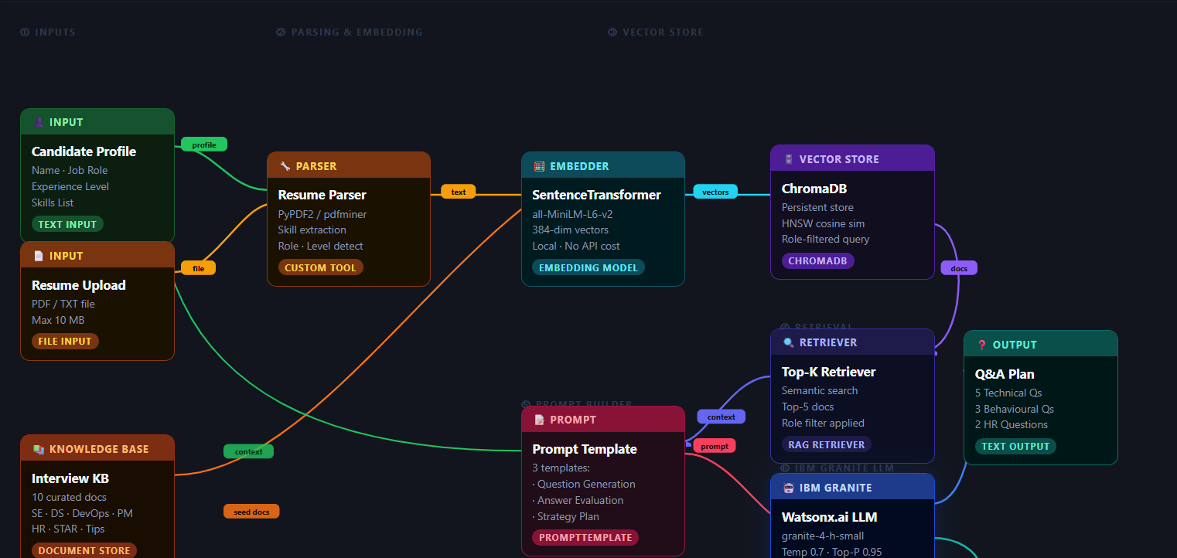
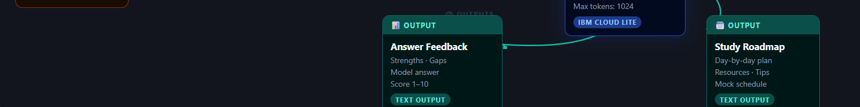
Langflow workflow

Slide 10



Architecture blueprint

Slide 11
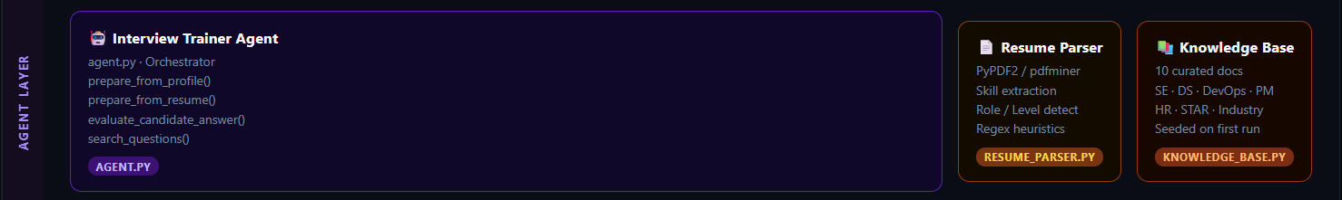
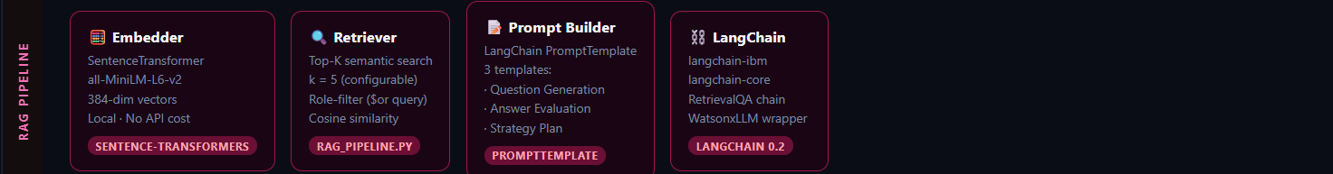
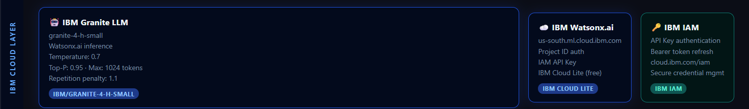

Slide 12


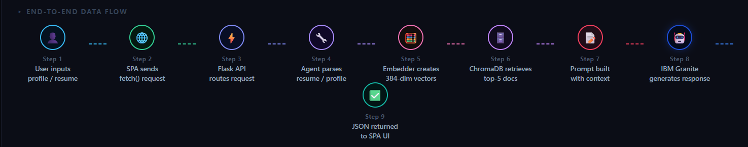

Slide 13

Role of Agentic AI in the solution
Role of Agentic AI in Interview Trainer Agent:
Agentic AI enables the Interview Trainer Agent to function as an intelligent, autonomous system rather than a simple chatbot. Using IBM watsonx.ai and IBM Granite models, it coordinates multiple specialized agents to deliver personalized career and interview preparation guidance. Each agent performs a specific role—such as retrieving role-specific technical questions, generating structured study plans, assessing candidate responses, and providing model answers—while working collaboratively. This multi-agent approach ensures efficient task execution and accurate results.
Agentic AI also brings context awareness, understanding user details like target job role, experience level, and key skills to generate tailored recommendations. It supports real-time adaptation, continuously updating preparation strategies based on user progress and input. Additionally, agents communicate with each other, enabling better decision-making and improved outcomes.
Overall, Agentic AI makes the system proactive, personalized, and goal-driven, acting like a smart digital career coach that helps job seekers master competitive hiring environments.

Slide 14
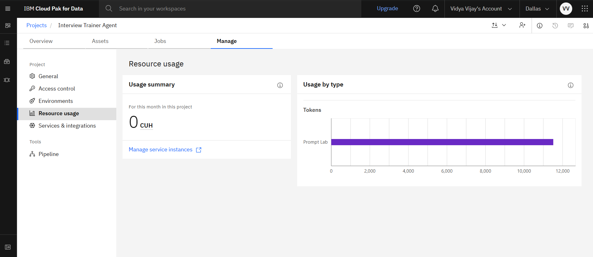
Token Usage
~12,000 Tokens Consumed (IBM Lite Tier)
·
·
·

Slide 15
Novelty and Uniqueness
Core Novelty
RAG-Powered Personalisation : Unlike static question banks or generic chatbots, this agent dynamically retrieves role-specific, level-aware interview content from a live vector store (ChromaDB) and fuses it with the candidate's own profile before generation — every response is unique to that person.
IBM Granite on Cloud Lite : Leverages IBM's open-source Granite LLM via Watsonx.ai — a truly enterprise-grade model accessible on the free IBM Cloud Lite tier. No proprietary API lock-in. Transparent, auditable, and deployable at zero cost for students and educators.
Resume → Interview Plan in Seconds : Upload a PDF resume and receive a fully tailored interview plan — auto-detected role, experience level, skill extraction, vector indexing, and AI-generated Q&A — in a single pipeline flow. No manual form-filling required.

Slide 16
What Makes It Unique
Dual-Mode Input : Accepts both manual profile entry and resume upload — adapting to users with or without a polished CV.
3-in-1 AI Features : Single agent handles Question Generation, Answer Evaluation with scoring, and a day-by-day Study Roadmap — no separate tools needed
Role-Filtered RAG : ChromaDB queries apply $or metadata filters so a DevOps candidate never gets Data Science questions mixed in
Zero Embedding Cost : Uses local SentenceTransformer (all-MiniLM-L6-v2) for all embeddings — 384-dim vectors generated on-device, no API spend on vectorisation.
Scored Answer Feedback : Evaluator returns Strengths, Areas for Improvement, a Model Answer, and a numeric 1–10 score — actionable, not just generic praise.
Timeline-Aware Roadmap : Candidate sets 7–90 day prep window; the strategy prompt generates a proportional day-by-day plan, adjusting depth to the available time.
Privacy-First Design : Resumes are deleted from disk immediately after parsing. No user data persisted beyond the vector embedding — aligned with data minimisation principles.
10 Job Roles Supported : Covers SE, Data Science, DevOps, Frontend, Backend, Full Stack, Product, Data Analyst, AI/ML, and Cybersecurity — the widest coverage of any open-source interview trainer

Slide 17
Git Hub Link
https://github.com/pje-063/AICTE-BOB-.git
·
·
·

Slide 18
Future Scope
Advanced Video & Body Language Analysis : Integrate computer vision models (such as MediaPipe or OpenCV) to analyze candidate eye contact, posture, and facial expressions during mock interviews, providing holistic feedback on non-verbal communication.
Real-Time Voice Interaction (Speech-to-Text & Text-to-Speech) : Upgrade the platform from text chat to live voice-based conversations using Whisper or IBM Watson Speech services, simulating an authentic, high-pressure phone or video interview environment.
Dynamic Company-Specific Question Banks : Expand the RAG knowledge base to automatically scrape and ingest recent interview experiences and role-specific technical question patterns from top-tier tech companies (e.g., FAANG and regional enterprises) for targeted preparation.
Peer Mock Interview & HR Dashboard : Introduce a multi-user portal allowing human recruiters or peer mentors to review candidate performance metrics, view historical progress charts, and assign custom interview modules.
·
·
·

Slide 19
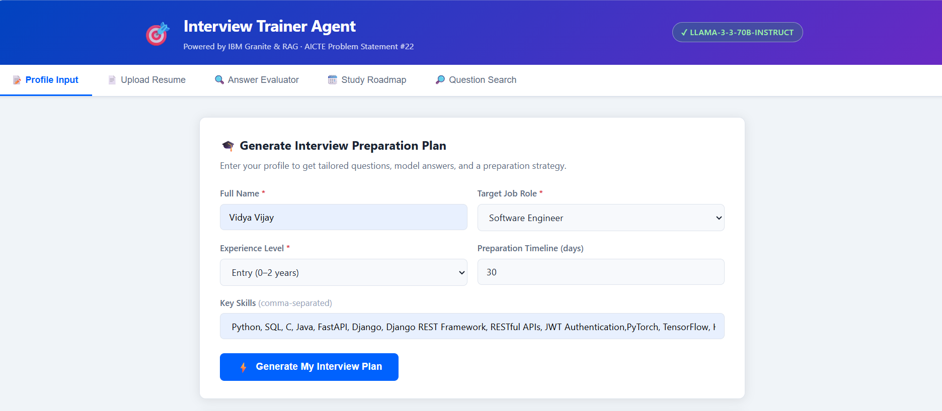
OUTPUT

Slide 20
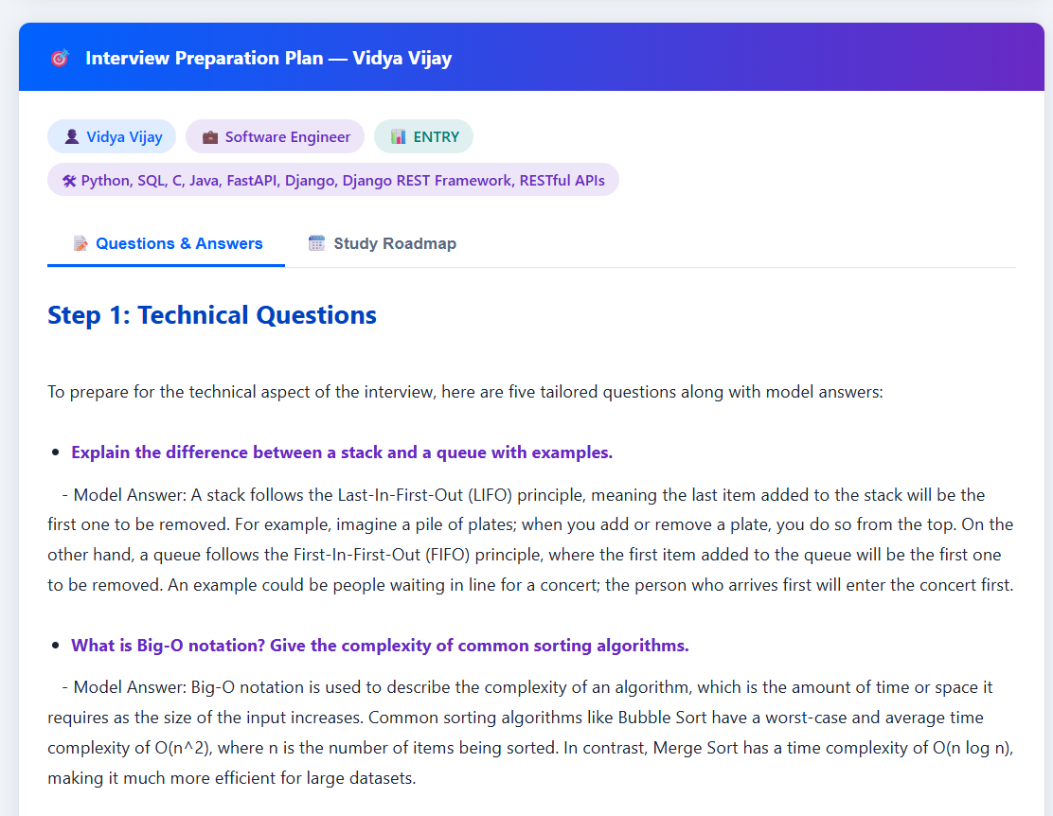
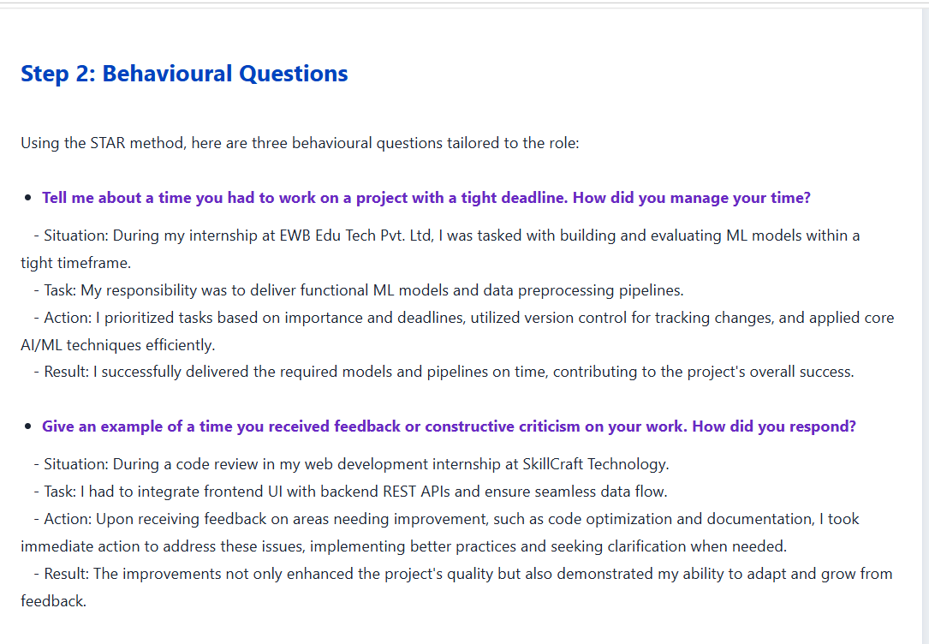

Slide 21
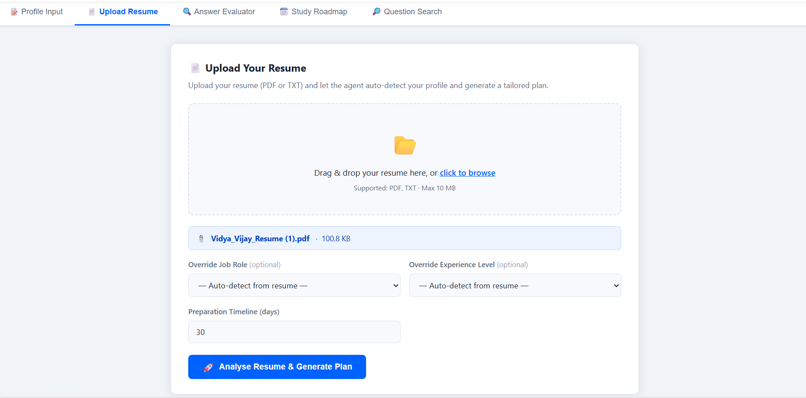

Slide 22
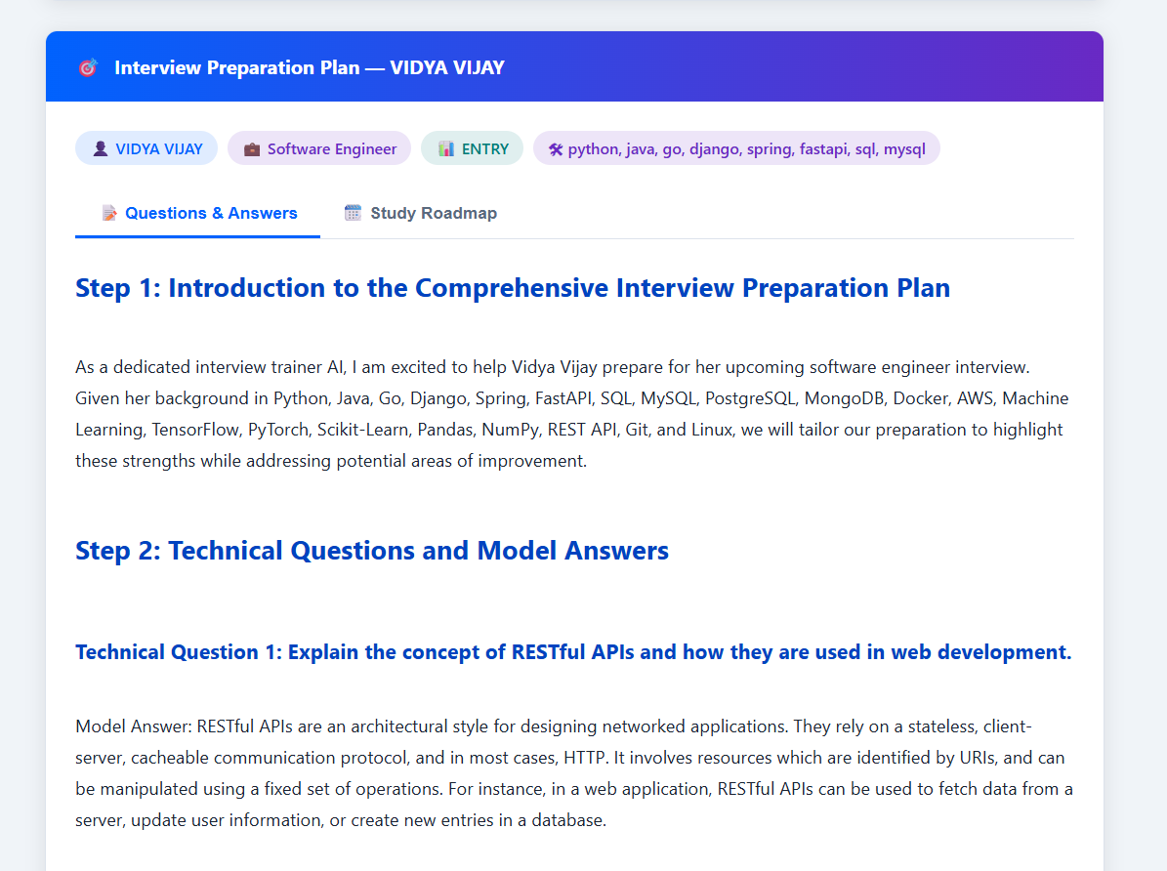
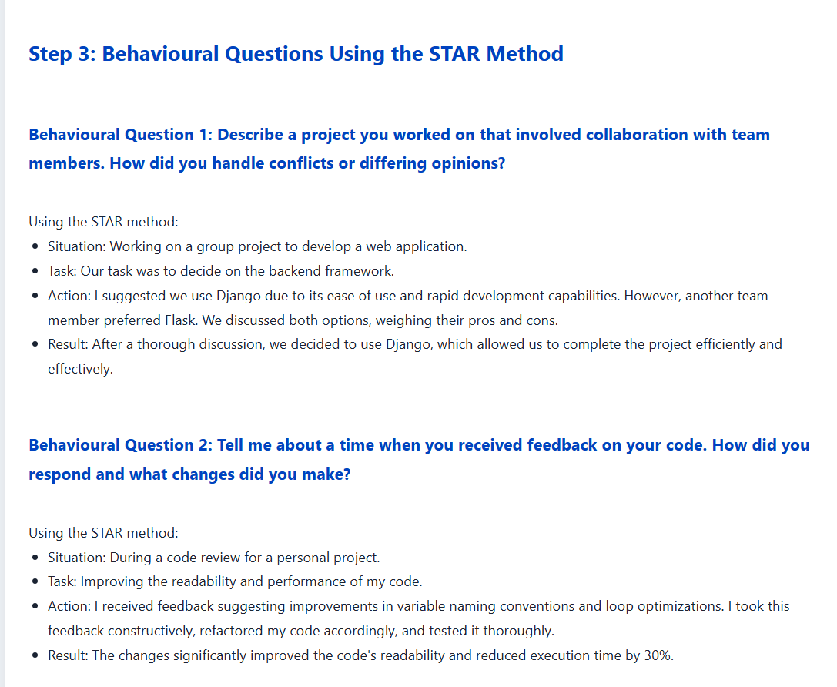

Slide 23
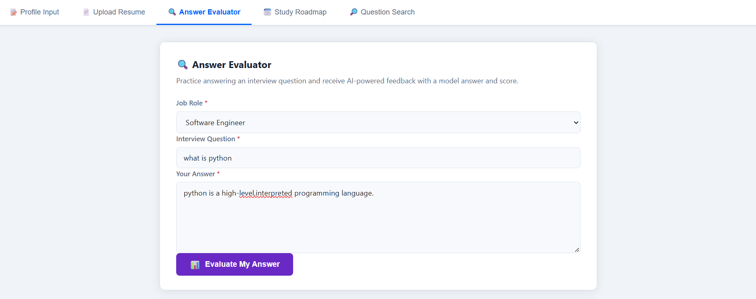

Slide 24
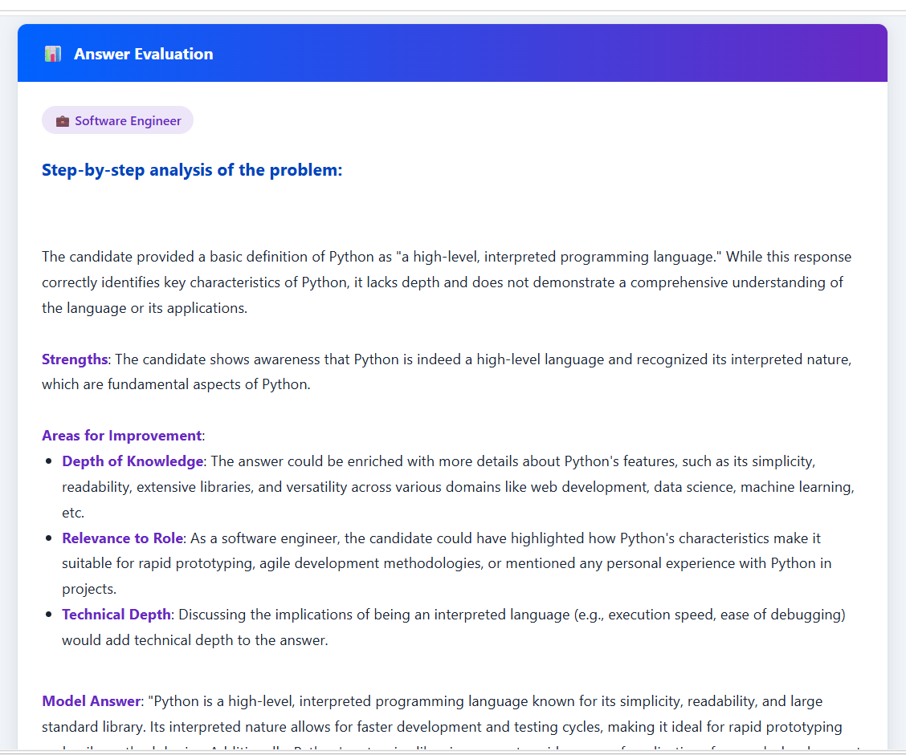
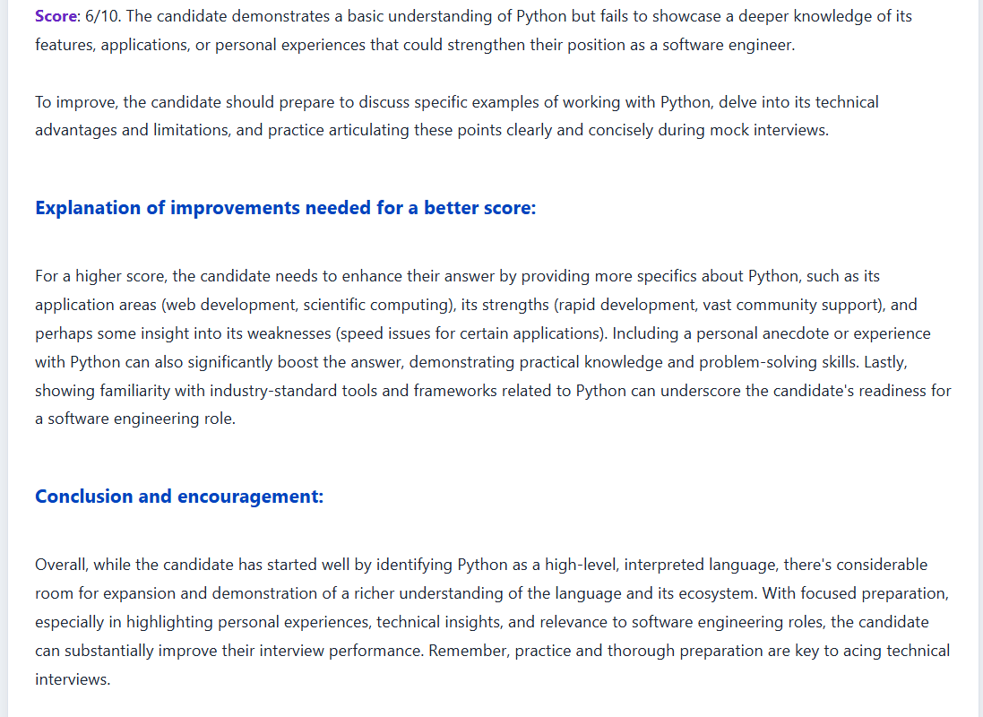

Slide 25
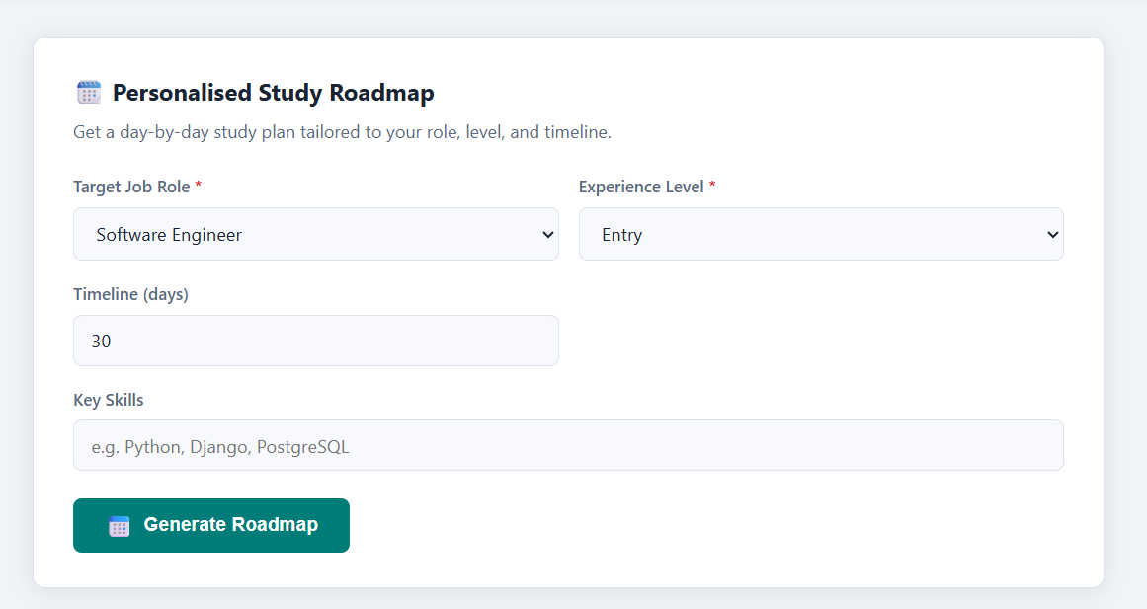

Slide 26
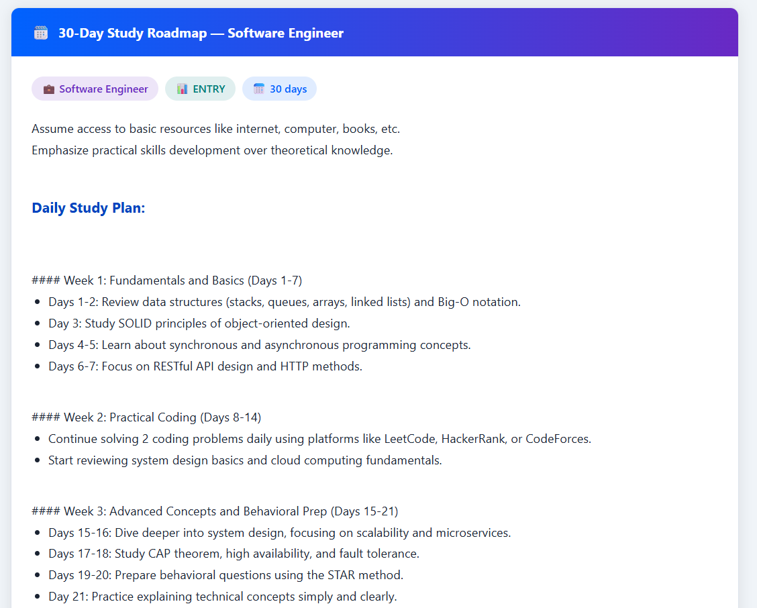
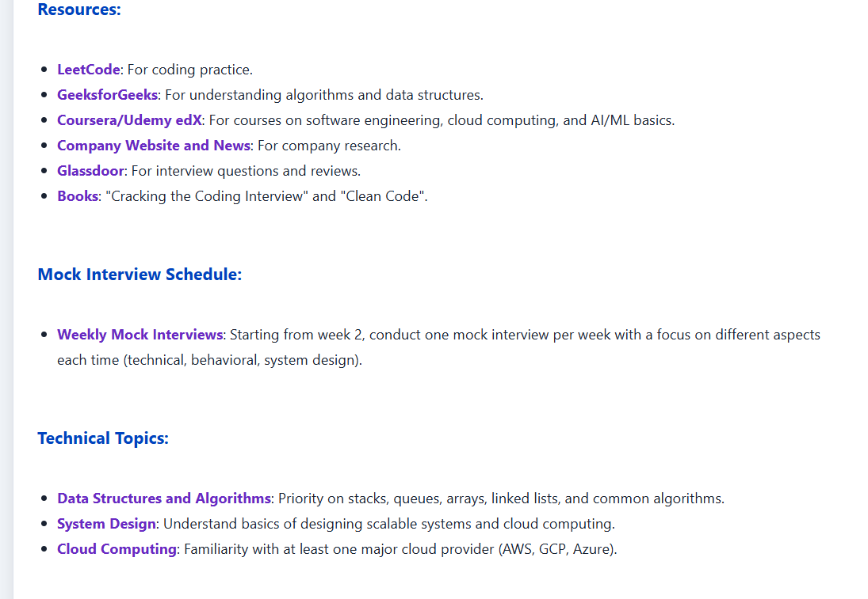

Slide 27
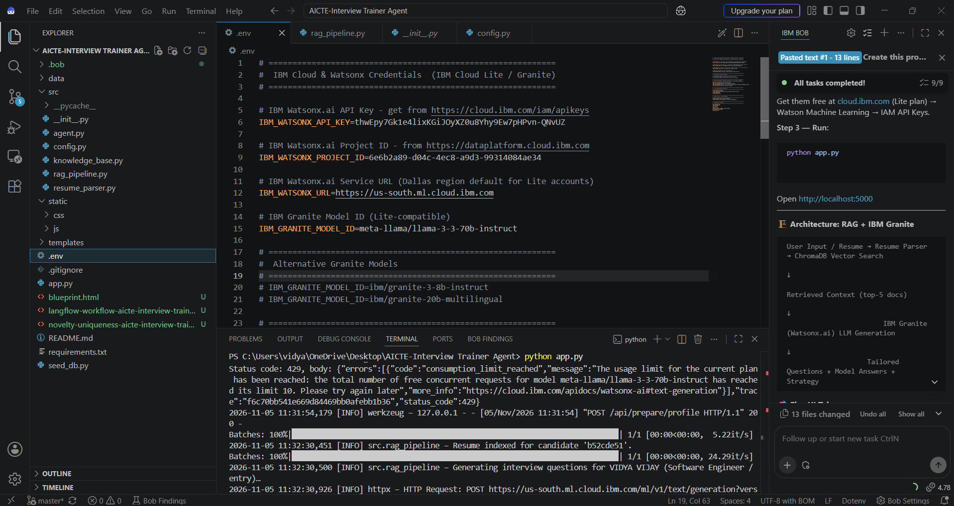
IBM BOB

Slide 28
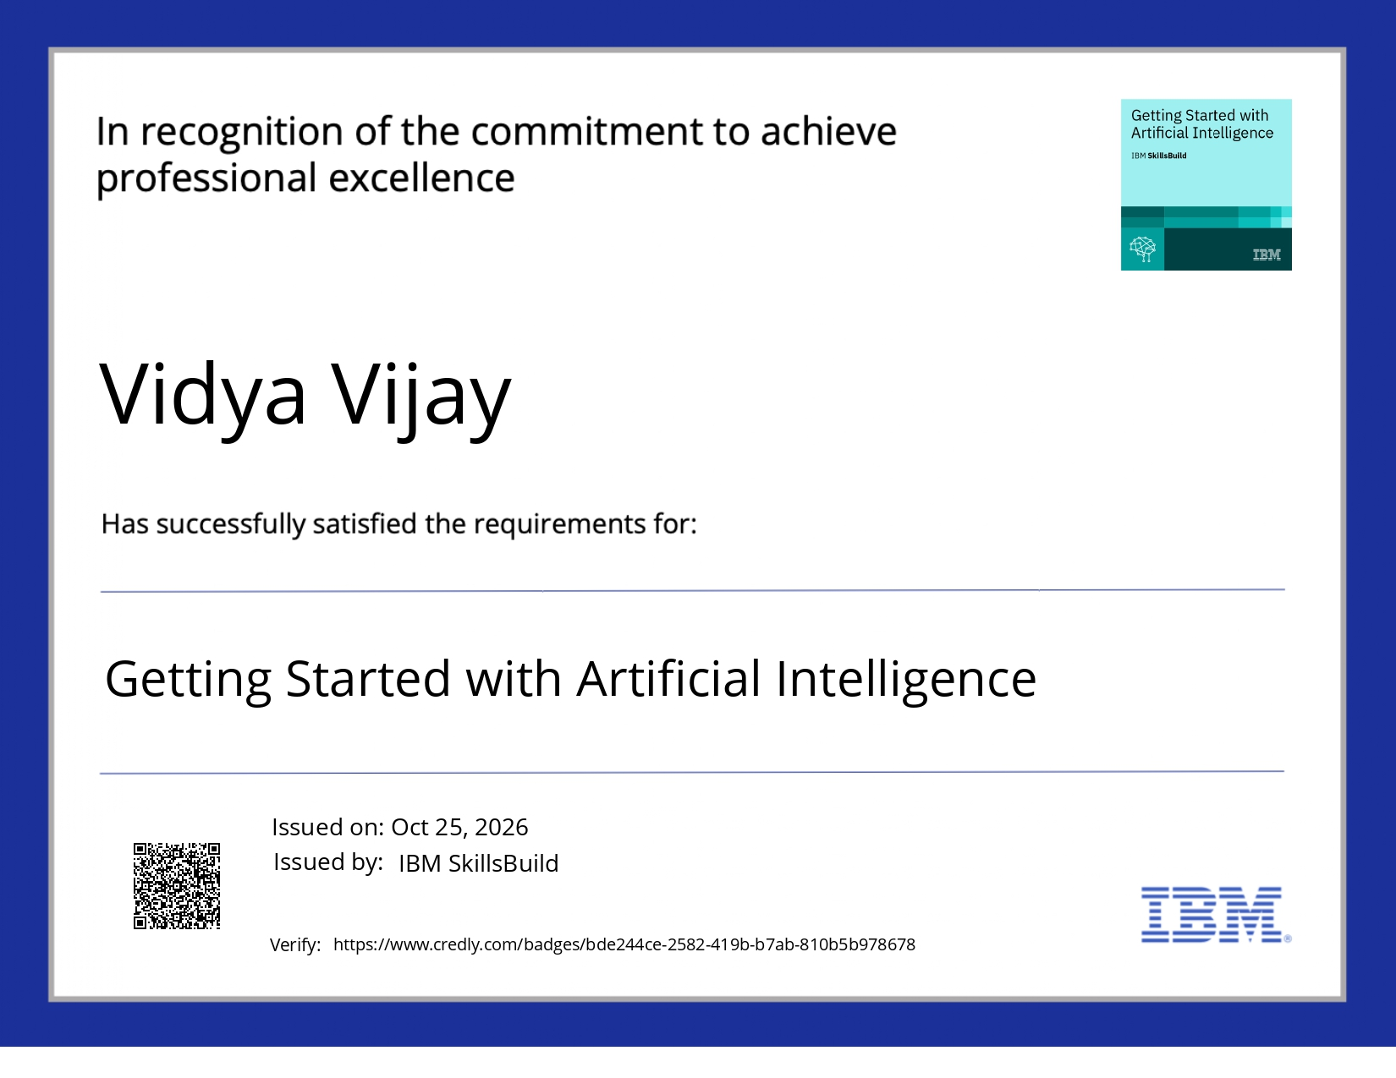
Certificates Earned:

Slide 29

Certificates Earned:​

Slide 30


